Slide 1
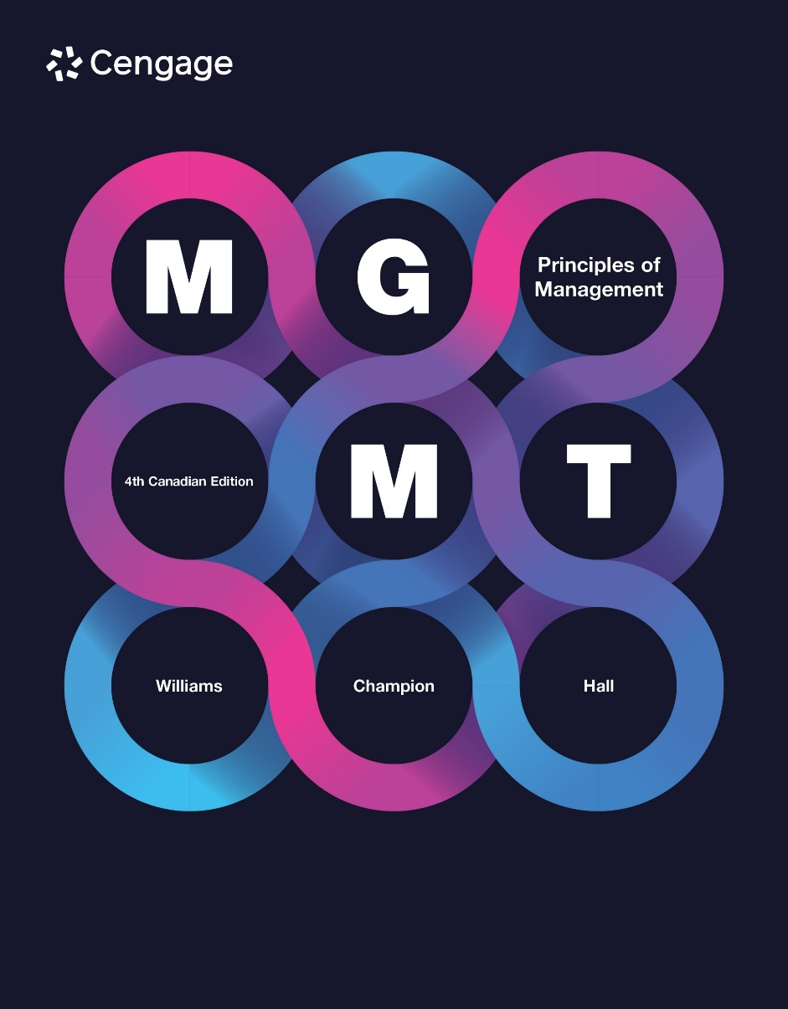

Slide 2
Chapter 17
Managing Service Operations
16 Oct 2025
Dr Ike Hall

Slide 3
Class Activity: Productivity
How productive are you on a scale of 1 to 10, with 10 being extremely productive?
What keeps you from being more productive?
What is productivity?
Discuss as a class.
17-3
Notes:
After polling a few students, ask, “What is productivity?”

Slide 4
Productivity
Outputs
Productivity
Inputs
Productivity: measure of performance that indicates how efficiently goods and services are produced
4
17-4
Notes:
Managing the daily production of goods and services, or operations management, is a key part of a manager’s job. But an organization’s success depends on the quality of its products and services as well as on its productivity. Productivity measures how efficiently goods and services are produced. The fewer inputs it takes to create an output (or the greater the output from one input), the higher the productivity. In essence, productivity is doing more with the same amount of time, energy, or resources.
At their core, organizations are production systems. Companies combine inputs, such as labour, raw materials, capital, and knowledge, to produce outputs in the form of finished products or services.

Slide 5
Why Productivity Matters
Higher
Productivity
Lower
Costs
Lower
Prices
Higher
Standard
of Living
Higher
Profits
Higher
Market
Share
17-5
Notes:
Why does productivity matter? For companies, higher productivity—that is, doing more with less—can lead to lower costs for the company, lower prices to customers, faster service, higher market share, and higher profits.
A more productive worker is a more profitable one as increased productivity means increased output and increased sales revenue. Since profits generated by each worker increase, companies will often decide to hire more workers to keep boosting profits. In a competitive labour market, the increase in the demand for labour places upward pressure on wages, and an increase in output supplied to a competitive goods market will drive prices down. For households, that translates into additional income without loss of purchasing power. For businesses, higher productivity means profit growth; for governments, additional tax revenues can support healthcare, education, and/or social services. For the country as a whole, productivity makes products more affordable or better.
For countries, productivity matters because it produces a higher standard of living. One way productivity generates a higher standard of living is through increased wages. When companies can do more with less, they can raise employee wages without increasing prices or sacrificing normal profits. Rising income stemming from increased productivity creates other benefits, such as new jobs and increased donations to charity.
In Canada over the last 20 years, annual economic growth has averaged about 2.2 percent, while mean productivity growth was just about 0.8 percent per year. Compared to the US levels, Canada’s productivity levels have continued to drop—from 80 percent of the US levels in 2000 to 76 percent in 2019. Compared to member countries of the Organization for Economic Cooperation and Development (OECD), Canada ranked 25th out of 36 countries over the period 2000 to 2019. Had Canada’s growth rate after 2000 matched the average of OECD member countries, the average Canadian’s pay would have been $2,900 higher.

Slide 6
Kinds of Productivity
Outputs
Single Kind of Input
Partial Productivity =
Multifactor
Productivity
Outputs
Labour + Capital + Materials + Energy
=
17-6
Notes:
Partial productivity: how much of a particular kind of input it takes to produce an output. Labour is one kind of input that is frequently used when determining partial productivity.
Labour productivity: the cost or number of hours of labour it takes to produce an output. In other words, the smaller the cost of the labour to produce a unit of output, or the less time it takes to produce a unit of output, the higher the labour productivity. For example, the automobile industry often measures labour productivity by determining the average number of hours of labour it takes to completely assemble a car.
Multifactor productivity: overall measure of productivity that assesses how efficiently companies use all the inputs it takes to make outputs. More specifically, how much labour, capital, materials, and energy it takes to produce an output.

Slide 7
Productivity and Automation
Process automation—using robots to automate routine, highly repetitive, low complexity, or single purpose tasks
Intelligent recognition—using automation programming to recognize and react to patterns of speech, written language, images, and other items
Collaborative/social automation—using robots to automate tasks while working directly with or near people
Notes:
Process automation is using robots to automate routine, highly repetitive, low complexity, or single purpose tasks. This works well in manufacturing facilities where a robot is dedicated to one task or a limited set of tasks, or in the automation of data collection and processing.
Intelligent recognition is using automation programming to recognize and react to patterns of speech, written language, images, and other items. When you say, “Hey Google,” or “Hey Siri,” to your smartphone, followed by a command such as finding something on the Web or getting directions, you are using intelligent recognition automation.
Collaborative/social automation is using robots to automate tasks while working directly with or near people. Worker safety was one of the earliest concerns with using robots in factories. Because robots were typically used for physically demanding tasks requiring high levels of force, they were surrounded by steel cages or industrial fencing so that people couldn’t be harmed by walking into the robot’s workspace. By contrast, collaborative/social automation puts workers and robots side by side.

Slide 8
Quality
A product or service free of deficiencies
Two
Definitions
The characteristics of a
product or service that
satisfy customer needs
17-8
Notes:
The American Society for Quality gives two meanings for quality, as shown on this slide.

Slide 9
Quality-Related Characteristics for Products and Services
Products
Reliability
Serviceability
Services
Reliability
Tangibles
Durability
Responsiveness
Empathy
Assurance
Notes:
Products
Reliability: average time between breakdowns
Serviceability: how easy or difficult it is to fix a product
Durability: the mean time to failure
Services
Reliability: ability to consistently perform a service well
Tangibles: the offices, equipment, and personnel involved with the delivery of a service
Responsiveness: promptness and willingness with which service providers give service
Assurance: the customer’s confidence that service providers will be knowledgeable, courteous, and trustworthy
Empathy: extent to which service providers give individual attention and care to customers’ concerns and problems

Slide 10
Quality: International Standards
ISO 9000
ISO 14000
ISO 27000
17-10
Notes:
9000 - a series of international standards for achieving consistency in quality management and quality assurance in companies throughout the world
14000 - a series of international standards for managing, monitoring, and minimizing an organization’s harmful effects on the environment
27000 - a series of 12 international standards for managing and monitoring security techniques for information technology

Slide 11
Quality: International Standards
ISO: International Organization for Standardization
ISO 9000
Five international standards (ISO 9000 to ISO 9004) for achieving consistency in quality management and quality assurance
ISO 14000
International standards for managing, monitoring, and minimizing an organization’s harmful effects on the environment
Notes:
Blog: http://www.iso.org/iso/home.html
ISO, pronounced eye-so, comes from the Greek word isos, meaning “equal, similar, alike, or identical” and is also an acronym for the International Organization for Standardization (IS0), an independent, non-governmental organization that publishes standards that facilitate the international exchange of goods and services.
ISO develops and publishes standards for products, services, and systems covering almost every category and industry, including information security, healthcare, general management, food safety, and energy management. ISO standards help to make products and systems compatible so they fit and work well with each other, ensure safety issues are addressed, and allow the sharing of technological know-how and best practices.
ISO 9000 is a series of five international standards, from ISO 9000 to ISO 9004, for achieving consistency in quality management and quality assurance in companies throughout the world.
An accredited third party oversees ISO certification, in much the same way that a certified public accountant verifies that a company’s financial accounts are up to date and accurate. Once a company has been certified as ISO compliant, the accredited third party issues an ISO certificate, which the company can use in its advertising and publications. Continued ISO certification is not guaranteed, however. Accredited third parties conduct periodic audits to ensure that the company is still following quality procedures. If it is not, its certification is suspended or cancelled.

Slide 12
Total Quality Management (TQM)
Customer Focus
Continuous Improvement
Teamwork
17-12
Notes:
Total quality management (TQM) is an integrated, organization-wide strategy for improving product and service quality. TQM is not a specific tool or technique. Rather, it is a philosophy and overall approach to management based on three principles: customer focus and satisfaction, continuous improvement, and teamwork. Contrary to the opinions of most economists, accountants, and financiers, who argue that companies exist to earn profits for shareholders, TQM suggests that customer focus and customer satisfaction should be a company’s primary goals.
Customer focus: the entire organization, from top to bottom, should be focused on meeting customers’ needs. The result of customer focus should be customer satisfaction: an organizational goal to make products or deliver services that meet or exceed customers’ expectations.
Continuous improvement: the ongoing commitment to increase product and service quality by constantly assessing and improving the processes and procedures used to create those products and services. How do companies know whether they’re achieving continuous improvement? Besides higher customer satisfaction, continuous improvement is usually associated with reduced variation.
Variation: deviation in the form, condition, or appearance of a product from the quality standard for that product. The less a product varies from its quality standard, or the more consistently a company’s products meet their quality standard, the higher the quality.
Six Sigma: a data-driven approach and methodology that strives to eliminate defects from products and services with a goal of having no more than 3.4 defects per million units or procedures; a quality improvement program most associated with continuous improvement.
3. Teamwork: collaboration between managers and non-managers, across business functions, and between the company and its customers and suppliers
Customer focus and satisfaction, continuous improvement, and teamwork mutually reinforce one another to improve quality throughout a company. Customer-focused continuous improvement is necessary to increase customer satisfaction. At the same time, continuous improvement depends on teamwork from different functional and hierarchical parts of the company.

Slide 13
Service Operations
Goods
Produced/Made
Services
Performed
Intangible
Perishable
Tangible
Storable
17-16

Slide 14
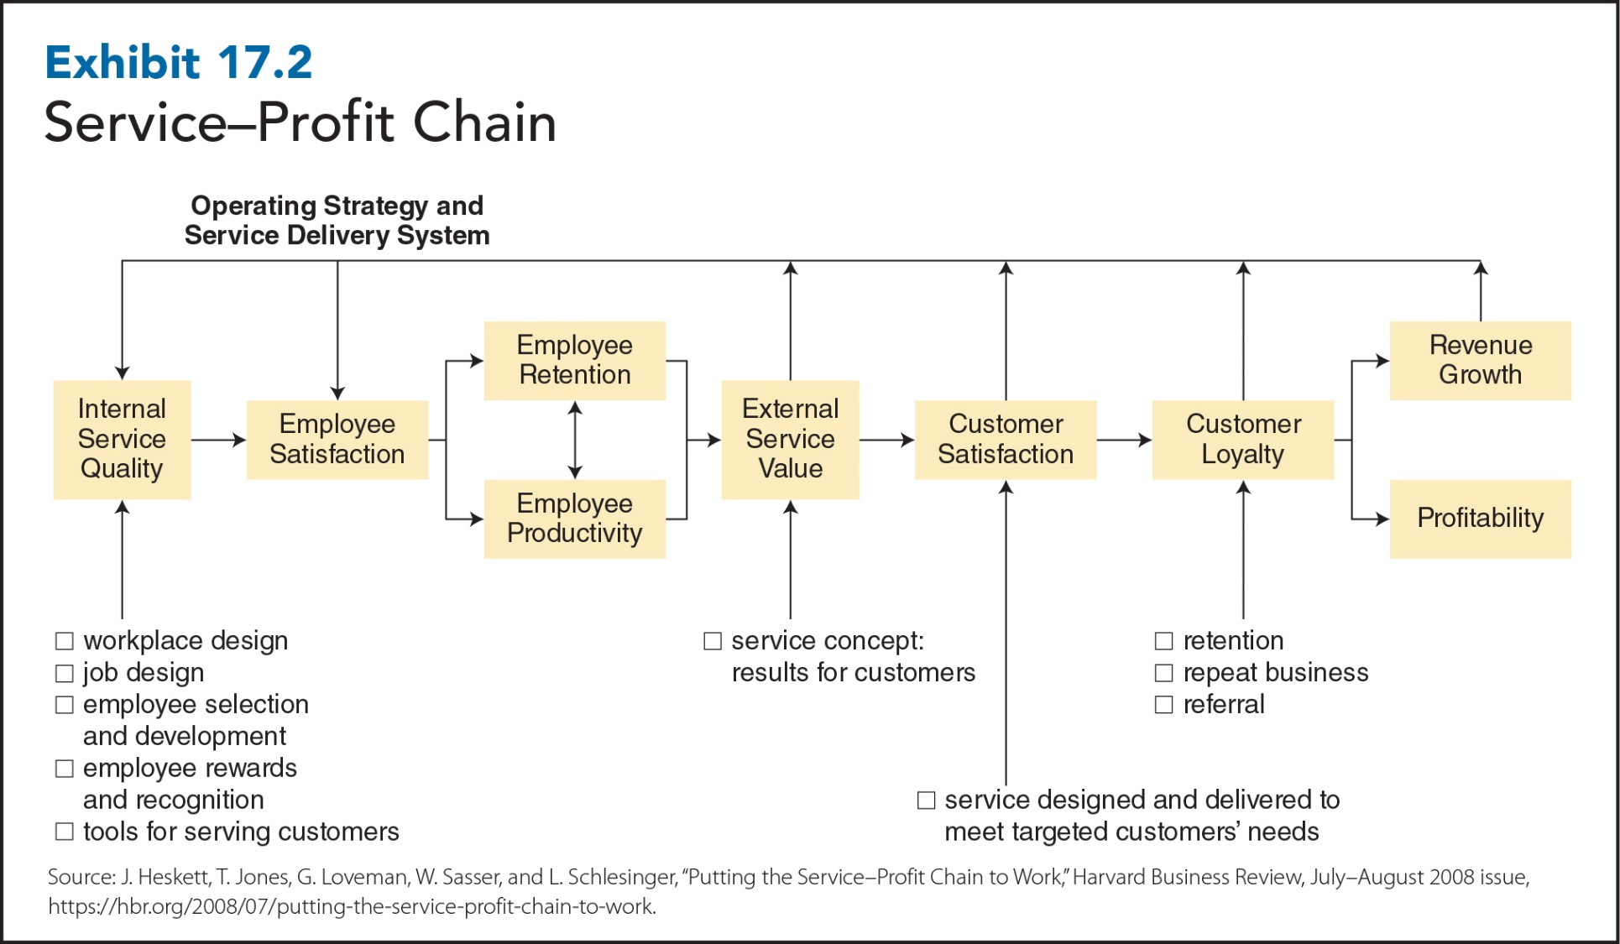
17-14
Notes:
A key assumption in the service business is that success depends on how well employees—that is, service providers—deliver their services to customers. But success actually begins with how well management treats service employees, as illustrated in the service–profit chain exhibit.
The service–profit chain establishes relationships between profitability, customer loyalty, and employee satisfaction, loyalty, and productivity.
The links in the chain are as follows:
Profit and growth are stimulated primarily by customer loyalty. Loyalty is a direct result of customer satisfaction. Satisfaction is largely influenced by the value of services provided to customers. Value is created by satisfied, loyal, and productive employees. Employee satisfaction, in turn, results primarily from high-quality support services and policies that enable employees to deliver results to customers.
The driving factor in the chain is internal service quality: the quality of treatment that employees receive from a company’s internal service providers, such as management, payroll and benefits, human resources, and so forth. It relates to employee satisfaction, which then influences external service value for customers. Employee satisfaction is influenced by how companies treat employees and is directly related to employee retention and employee productivity. In other words, the better employees are treated, the more satisfied they are, and the more likely they are to believe that they can and ought to provide high-value service to customers. High external value service leads to customer satisfaction and customer loyalty, which, in turn, leads to revenue growth and profitability.

Slide 15
Service Recovery and Empowerment
Service Recovery
Restoring customer satisfaction to strongly dissatisfied customers
Fixing the mistakes that were committed
Employee Empowerment
Goal: immediate solution to customer problems
Notes:
While the production-line model excels at efficiency and low costs, it doesn’t work well when mistakes are made and customers have become dissatisfied with the service they’ve received. When this occurs, service businesses must switch from the process of service delivery to the process of service recovery: restoring customer satisfaction to strongly dissatisfied customers. Sometimes, service recovery requires service employees not only to fix whatever mistake was made but also to perform service acts that delight highly dissatisfied customers by far surpassing their expectations of fair treatment.
Unfortunately, when mistakes occur, service employees often don’t have the discretion to resolve customer complaints. However, many companies are now empowering their service employees. Empowering workers: permanently passing decision-making authority and responsibility from managers to workers. With respect to service recovery, empowering workers gives service employees the authority and responsibility to make decisions that immediately solve customer problems. (As explained in Chapter 15, the purpose of empowering service employees is zero customer defections—turning dissatisfied customers back into satisfied customers who continue to do business with the company.)

